Slide 1
Mushroom Classification
Data Science Project​

Slide 2
AGENDA
Introduction​
Primary goals
Plan For Project Execution and Timeline
EDA
Model Building
Deployment

Slide 3
Introduction
Mushroom is one of the fungi type food that has the most potent nutrients on the plants
Mushroom have major medical advantage such as killing cancer
This study aims to find the most appropriate technique for mushroom classification and mushroom will be classified into two categories, , Poisonous and edible

Slide 4
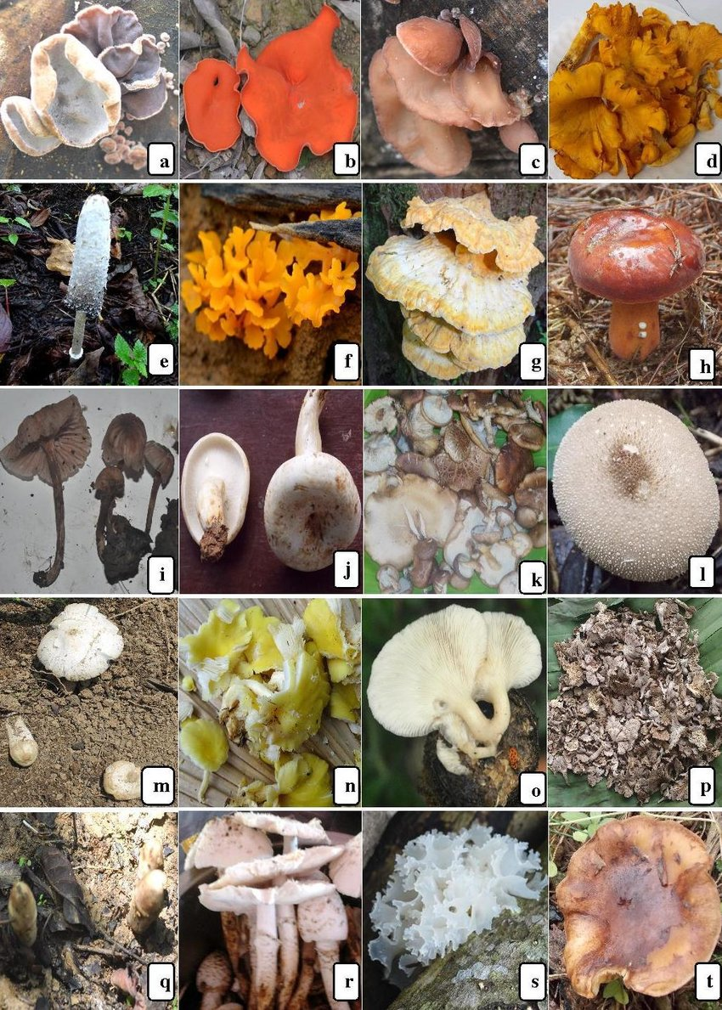
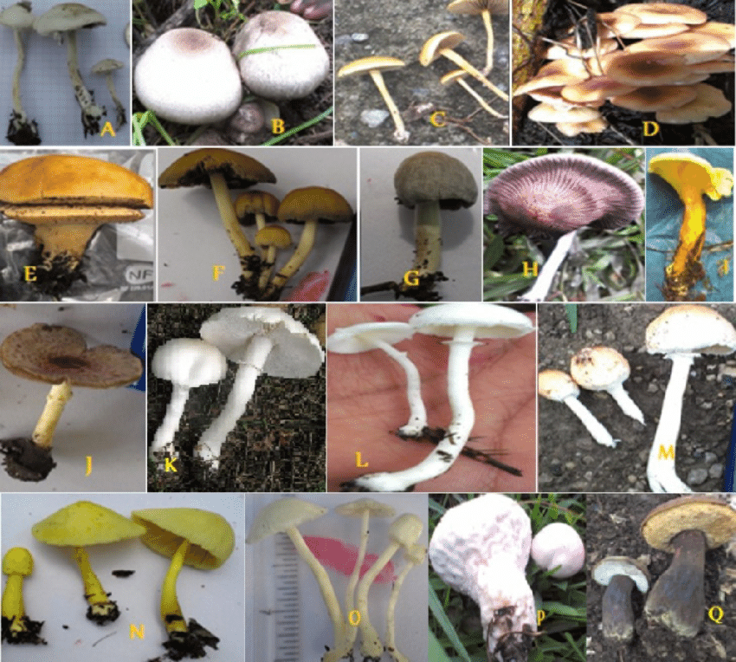
Edible Mushrooms
Fig.1
Fig.2

Slide 5
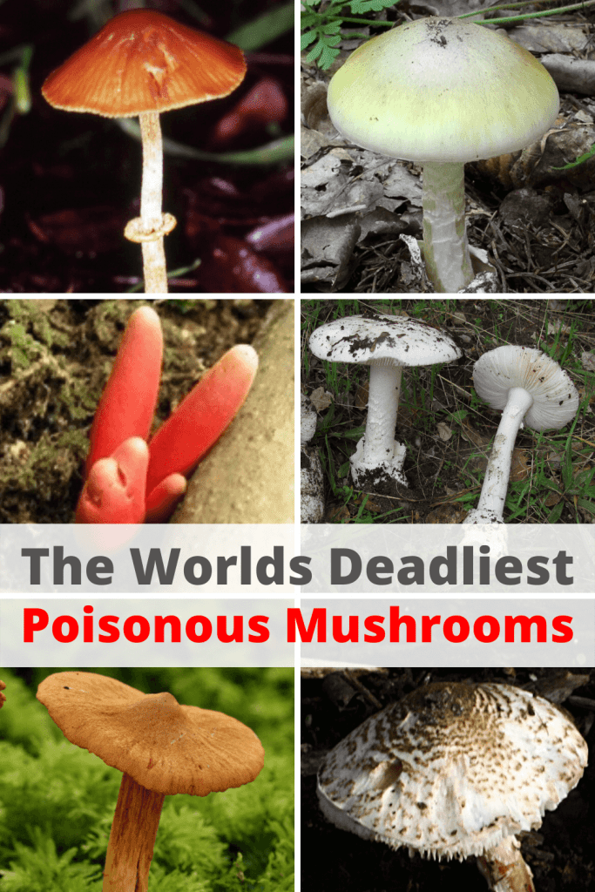
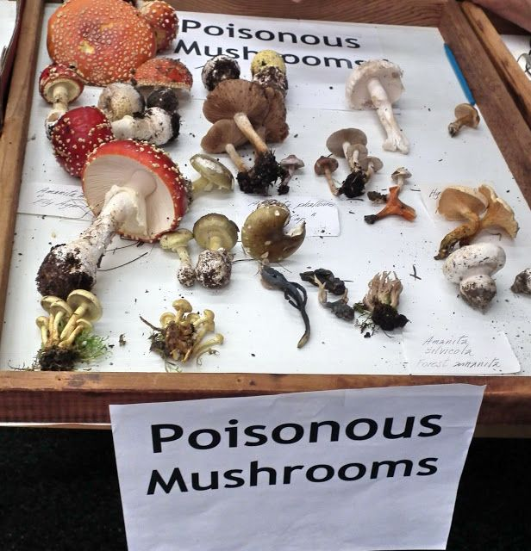
Poisonous Mushrooms
Fig.3
Fig.4

Slide 6
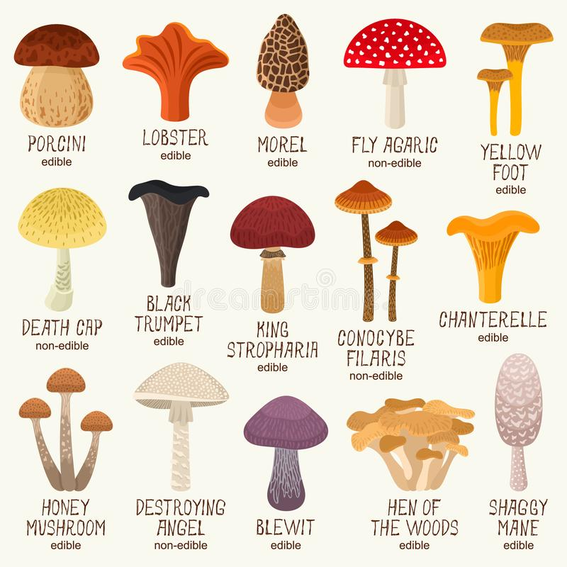
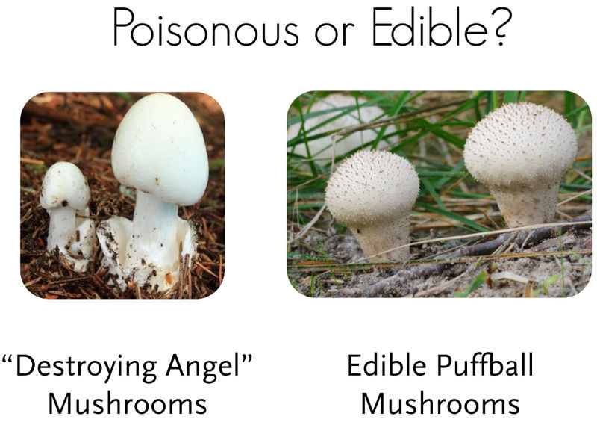
Mushrooms
Fig.5
Fig.6

Slide 7





PLAN FOR project execution
Row data
Basic step
visualization
Model building
deployment
Getting row data from client get information about the data
Checking primary requirement of client
Perform EDA to get the details from the data
Build the various classification model to get who's model fit and getting best accuracy
Deploy strategic model with compelling client needs

Slide 8
TIMELINE
Aug 3 week
Aug 4 week
Sep 1 week
Sep 2 week
Data Cleaning , Data Preprocessing , EDA
Various Model Building
Deployment with finalized Model
Presentation of Our work on Mushroom classification model

Slide 9
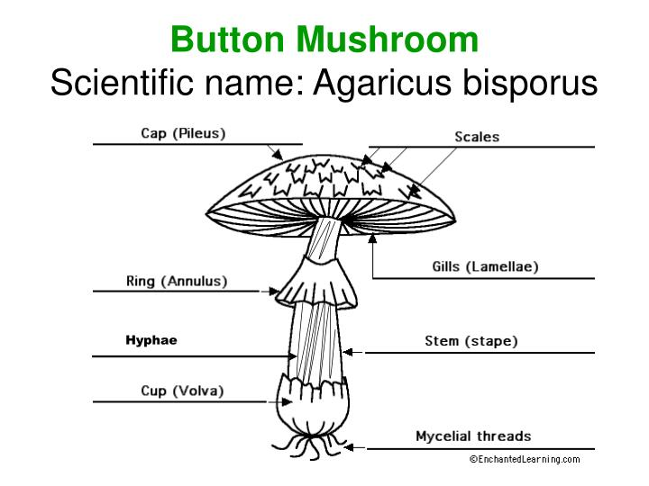
PRIMARY GOALS
Nowadays, there are different challenges to develop systems that analyze a huge and complex data to make better decisions.
This study aims to find new approach working to classify the mushrooms based on different features using the different techniques of Machine Learning (ML).
In the proposed approach, we used the training dataset that contain the mushroom data to classify it into poisonous and edible.
The data set contains mentioned features of the mushroom which can be seen in the image.
FIG.7
Mushroom Specification

Slide 10
This project aims at developing a machine-learning algorithm that will determine if a certain mushroom is edible or poisonous by its specifications like cap shape, cap color, gill color, etc. using different classifiers.
To do so, I have used the following classification methods:
Logistic Regressions
KNN
Support Vector Machine (SVM)
Decision Tree

Slide 11
EDA
Total count of
Edible and Poisonous

Slide 12
Cap shape
Comparison b/w
cap-shape and class
Count plot of cap-shape based on class

Slide 13
Cap surface
Comparison b/w
cap-surface and class
Count plot of
Cap surface on class

Slide 14
Cap - color
Comparison b/w
Cap color and class
Count plot of
Cap color on class

Slide 15
bruises
Comparison b/w
Bruises and class
Count plot of
Bruises on class

Slide 16
Gill-size
Comparison b/w
gill-size and class
Count plot of
Gill-size on class

Slide 17
Model Accuracy
Model | 0 | 1 | Accuracy | Macro Average | Weighted Average
Logistic Regression | 100 | 100 | 100 | 100 | 100
KNN | 99.88 | 99.87 | 99.88 | 99.88 | 99.88
SVM | 100 | 100 | 100 | 100 | 100
Decision Tree | 100 | 100 | 100 | 100 | 100
Random Forest | 100 | 100 | 100 | 100 | 100

Slide 18
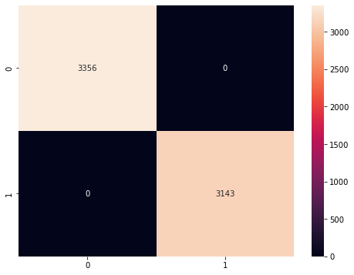
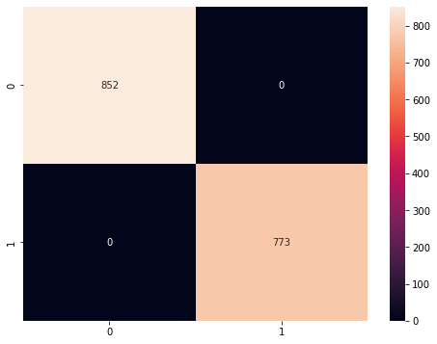
Logistic Regression Confusion Matrix
Training
Confusion matrix
Testing
Confusion matrix

Slide 19

k- nearest neighbors confusion matrix
Testing
Confusion matrix
Training
Confusion matrix

Slide 20
Support vector machine confusion matrix
Testing
Confusion matrix
Training
Confusion matrix

Slide 21
Decision tree

Slide 22
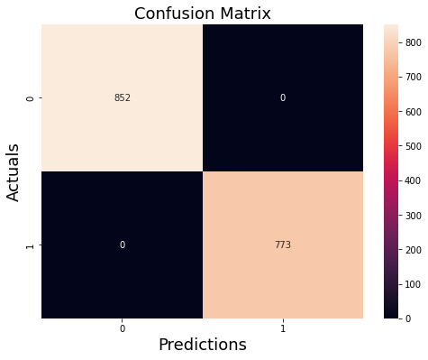
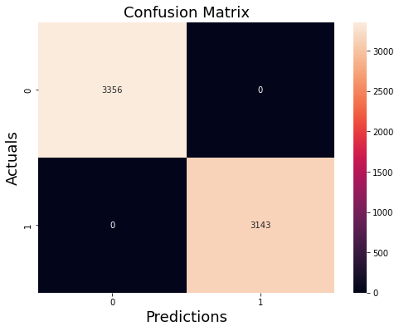
Decision tree confusion matrix
Testing
Confusion matrix
training
confusion matrix

Slide 23
Deployment
After completed project aim to developed various machine-learning algorithm that will determine if a certain mushroom is edible or poisonous by its specifications like cap surface, bruises, cap color, gill size, etc. using different classifiers.
After getting accuracy from various model classification we decided to use following classification method for Deployment:
Decision Tree

Slide 24
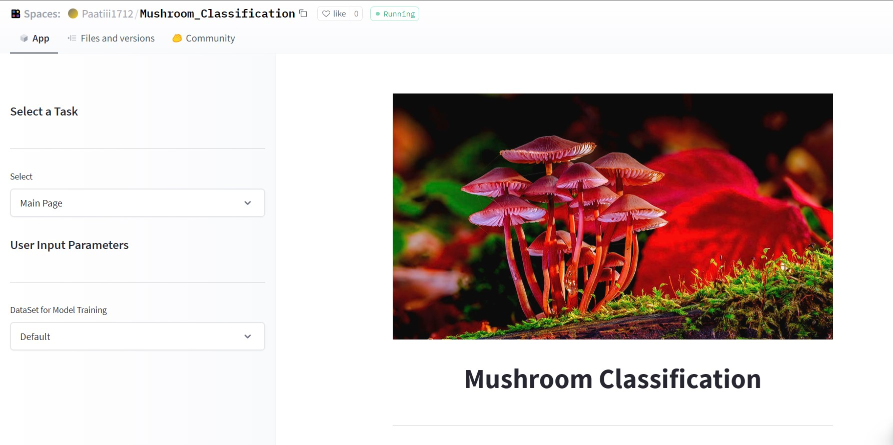
Deployment interface
Deployment link:

Slide 25
Working with team is like challenges and OPPORTUNITIES. THERE'S ALWAYS ANOTHER ONE COMING.
“
”

Slide 26
Group Member
Contact Details
Sr. No. | Name | Contact No. | G-mail | GitHub ID
1 | Ayush Patidar | 9131985346 | ayushpatidar1712@gmail.com | Ayushpaatii1712
2 | Anup Vetal | 8668314822 | anupsv1997@gmail.com | JustAnupSv
3 | Farzan Nawaz | 7898480467 | farzannawaz4787@gmail.com | Farzan04
4 | Prashant Khandekar | 7030870449 | pkhandekar108@gmail.com | Prashantkhandekar
5 | Prasad Waje | 8999714455 | prasadwaje2029@gmail.com | Prasadwaje

Slide 27
THANK YOU…😊

